Slide 1


EduMate: Your AI-Powered Student Assistant
EduMate is designed to simplify academic life, empowering students to learn more effectively and achieve their goals. Through its powerful AI features, EduMate offers a comprehensive solution for tackling the challenges of today's academic landscape.
by Runtime Terror

Slide 2
The Problem: Overwhelmed Students, Inefficient Study
Students are often overwhelmed by the sheer volume of information they need to process.
Traditional study methods can be time-consuming and inefficient.

Slide 3

Introducing EduMate: Simplify, Learn, Succeed
EduMate provides AI-powered solutions to common student challenges.
Streamline your workflow and make studying more efficient.
Achieve better understanding and improved academic performance.

Slide 4
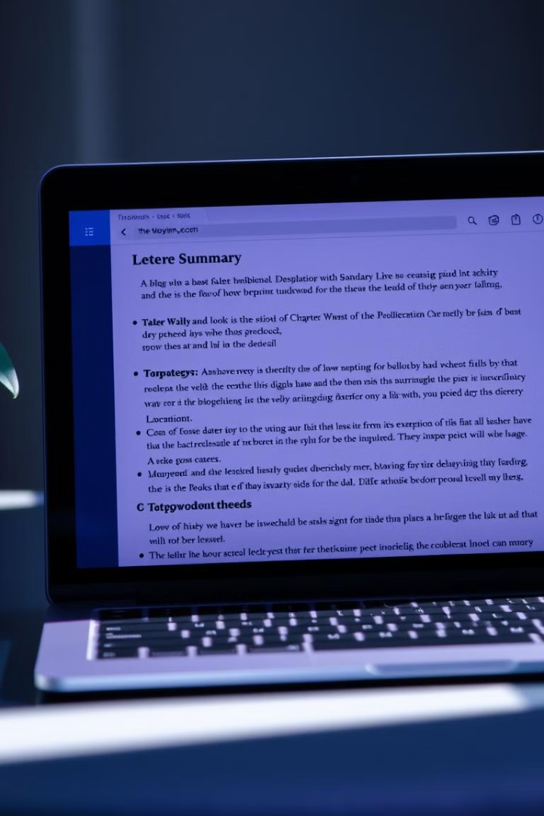
Core Function 1: AI Notes Summarizer - Conquer Your Reading
Upload your notes (PDF/PPTX) and get concise, easy-to-read summaries.
Identify key concepts and understand the main points of your reading.
Save time and effort by eliminating unnecessary information.

Slide 5



Core Function 2: Quick Concept Explainer - Instant Understanding
Enter any topic and receive instant, AI-powered explanations in simple terms.
Bridge gaps in your understanding and build a strong foundation.

Slide 6

Core Function 3: Smart Task Scheduler - Optimized Time Management
1
Plan study sessions and assignments with AI-generated, optimized schedules.
2
Allocate your time effectively and avoid procrastination.
3
Stay on top of your deadlines and manage your workload efficiently.

Slide 7

Demo Video
Video Link
EduMate AI-Powered Assistant is an innovative AI-driven platform designed to enhance digital learning experiences. This video showcases its key features, functionality, and real-world applications in education.

Slide 8

Thank you!
We Appreciate Your Questions and we Value Your Feedback.
✉️ Contact Us

